Slide 1
Operator Education Material –
National Rail Safety Data Strategy
April 2022

Slide 2
OVERVIEW
Introduction
Background and overview of the National Rail Safety Data Strategy
Legislation
Module 1 - Network & Operations (Ontology) Data
Module 2 – Notifiable Occurrences
Module 3 – Monthly Rail Operations Activity Data
Module 4 – Annual Reporting
Office of the National Rail Safety Regulator
2

Slide 3
INTRODUCTION
This information material is not an official ONRSR Guideline.
This material is made available to assist rail transport operators (RTOs) in training suitably experienced staff in relation to changes to the data collected by ONRSR.
Reference should also be made to the RTO’s safety management system and any other specific RTO requirements.
Copyright in this material vests in ONRSR. This material may be reproduced in whole or in part, provided the meaning is unchanged and source is acknowledged.
Office of the National Rail Safety Regulator
3

Slide 4
BACKGROUND
What is the National Rail Safety Data Strategy (NDS)?
A national approach for the capture, management of, and access to rail safety data
A joint initiative developed in partnership between ONRSR and the rail industry (represented by the Australian Railway Association; ARA)
Implementation has been overseen by the rail operator Steering Committee co-chaired by ARA and ONRSR
“
To have consistent, quality and accurate national rail safety data that is readily available to stakeholders when making decisions relating to rail safety
VISION
”
Office of the National Rail Safety Regulator
4

Slide 5
WHY
Three overarching themes:
1. Better focused national data
2. Better data quality
3. Better consistency and comparability
Office of the National Rail Safety Regulator
5

Slide 6
BENEFITS
The benefits of the implementation of the NDS include:
A single source of reliable national rail safety data
Consolidated reporting requirements
Improved industry information
A tool to assist in the provision of timely, accurate and relevant information about rail safety performance
Balance the need for data with the appropriate burden of collection
Provision of information to stakeholders to guide, improve risk management and safety management decision making and allowing benchmarking
Improved data for cost recovery
Office of the National Rail Safety Regulator
6

Slide 7
NDS OBJECTIVES
Meets the identified needs of governments, industry and other primary stakeholders
Reduced regulatory burden on industry
Supports the data needs of other stakeholders
(e.g ACRI, ALCAM, ATHRA, National and State Level Crossing Committees, TrackSafe)
Strategic Objectives
Provides timely, accurate and relevant information about rail safety performance
Supports decision-making about rail safety
Guides actions to improve rail safety
Office of the National Rail Safety Regulator
7

Slide 8
NOTIFIABLE OCCURRENCE DEFINITION
Notifiable Occurrence means an accident or incident associated with railway operations—
(a) that has, or could have, caused—
(i) significant property damage; or
(ii) serious injury; or
(iii) death; or
(b) that is, or is of a class that is, prescribed by the national regulations to be a notifiable occurrence or class of notifiable occurrence, but does not include an accident or incident, or class of accident or incident, that is prescribed by the national regulations not to be a notifiable occurrence
Office of the National Rail Safety Regulator
8

Slide 9
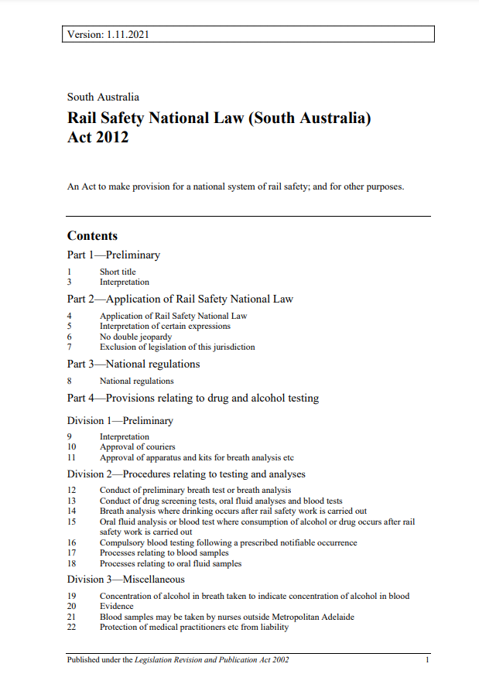
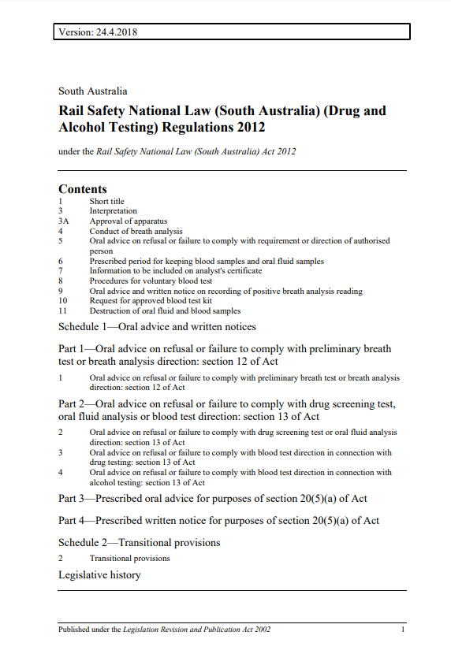
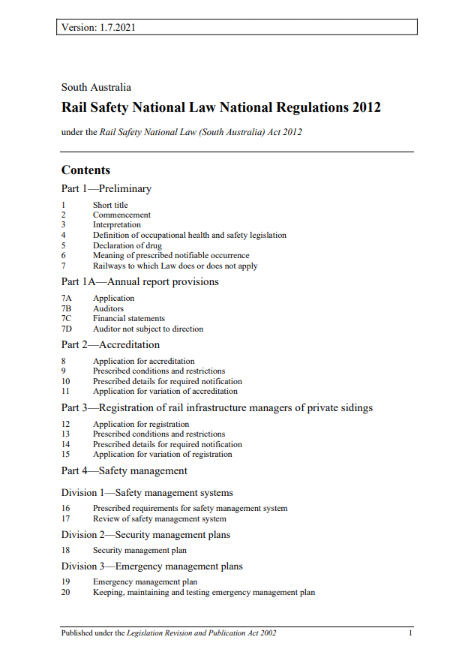
LEGISLATION
Legislative mechanisms relevant to occurrence reporting and data provision include the following:
Rail Safety National Law 2012
Section 121 - Notification of certain occurrences
Rail Safety National Law National Regulations 2012
Regulation 56 – Periodic information to be supplied
Regulation 57 - Reporting of notifiable occurrences
Regulation 17 – Review of safety management system
Regulation 28 - Drug and alcohol management program
Schedule 1, Clause 23 – Management of notifiable occurrences
Schedule 1A – Notifiable occurrences
Office of the National Rail Safety Regulator
9

Slide 10
HOW
The ONRSR Portal is for the submission of all occurrence information and data
Operators have a responsibility to ensure their systems are in place to facilitate information and data transfer
Office of the National Rail Safety Regulator
10

Slide 11
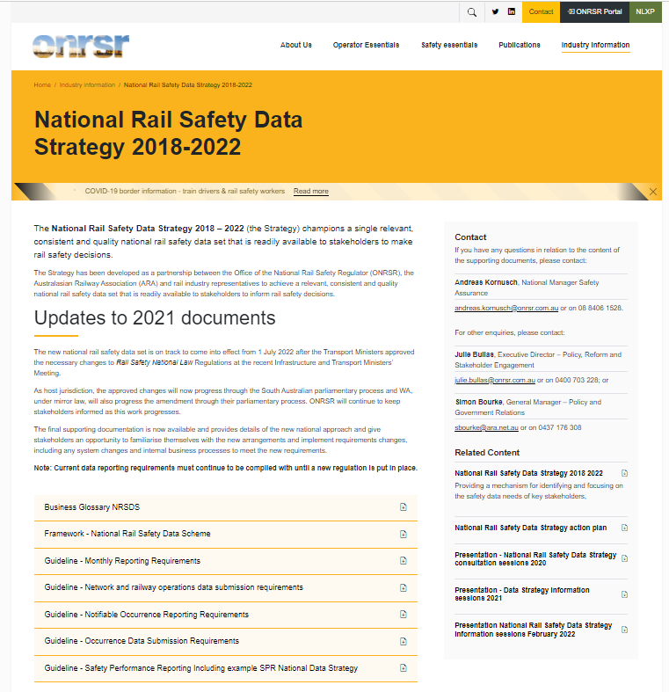
SUPPORTING MATERIAL
Notifiable Occurrence Reporting Requirements
Network and Railway Operations Data Submission Requirements
Monthly Activity Reporting
Occurrence Data Submission Requirements
Safety Performance Reporting
ONRSR Business Glossary
Video demonstration of a single derailment event report
Video demonstration of a 3-event collision report
Office of the National Rail Safety Regulator
11

Slide 12
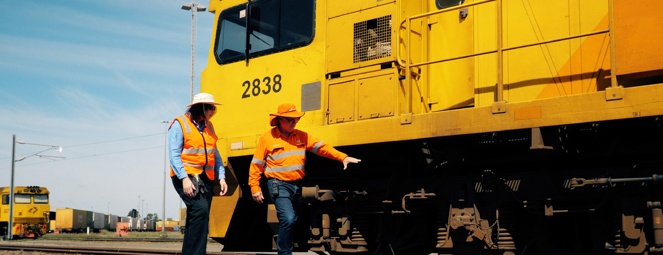
MODULE 1 – NETWORK & RAILWAY OPERATIONS (ONTOLOGY) DATA
Office of the National Rail Safety Regulator
12

Slide 13
NETWORK & RAILWAY OPERATONS (ONTOLOGY) DATA
This information is the geographical network and train operational characteristics data that provides an understanding of the nature and scope of an operator's railway operations.
Data may be consistent for the long term
Operators should ensure that there is a process in place for identifying changes to this data
Operators should ensure that any changes to the data is provided to ONRSR as soon as practicable
Regular review should take place to confirm currency of information
Office of the National Rail Safety Regulator
13

Slide 14
NETWORK & RAILWAY OPERATONS (ONTOLOGY) DATA
Rail Infrastructure Manager
(RIM)
Private Sidings
(registered RIMs)
Total track managed; operational and non-operational
Line section and track kilometres
Network interfaces
Level crossings
Key locations on the network
Connected RIM
Line kilometre connection point
Siding operations
Rolling Stock Operator
(RSO)
Stops / Stations utilised
Office of the National Rail Safety Regulator
14

Slide 15
LOCATION DATA
The relevant Rail Infrastructure Manager detail, such as line section and optional key location data (if provided) is made available to Rolling Stock Operators as reference data when reporting the location of an occurrence.
Office of the National Rail Safety Regulator
15

Slide 16
MODULE 2 – NOTIFIABLE OCCURRENCES
Office of the National Rail Safety Regulator
16

Slide 17
NOTIFIABLE OCCURRENCE REPORTING
Rail Transport Operators are required to report all notifiable occurrences that occur on, or in relation to, their railway premises or railway operations
Immediately notifiable occurrences (Category A’s) are reportable by phone to ONRSR
The information provided in the initial report is forwarded on to Australian Transport Safety Bureau (ATSB)
The initial report is used by ONRSR and ATSB to assess seriousness and response to the occurrence
Category A notifiable occurrence reports are initiated by the ONRSR Duty Officer within the ONRSR Portal and then record(s) are updated by the involved operator(s) (also via the Portal)
Office of the National Rail Safety Regulator
17

Slide 18
NOTIFIABLE OCCURRENCE REPORTING
For Category B Occurrences, where multiple operators are involved, there is one record created by the first operator to report the occurrence
Basic information on the occurrence is then available for the second operator – e.g Incident type, when, where
Network (RIM) ontology data is available in the Portal to relevant rolling stock operators that operate on that network
It is important that operators do not assume the other operator has reported
Office of the National Rail Safety Regulator
18

Slide 19
DEFINITIONS - EXAMPLE
Train means –
2 or more units of rolling stock coupled together, at least 1 of which is a locomotive or other self-propelled unit; or
a unit of rolling stock that is a locomotive or other self-propelled unit
Rolling stock means a vehicle that operates on or uses a railway, and includes a locomotive, carriage, rail car, rail motor, light rail vehicle, train, tram, light inspection vehicle, self-propelled infrastructure maintenance vehicle, trolley, wagon or monorail vehicle, but does not include a vehicle designed to operate both on and off a railway when the vehicle is not operating on a railway.
Reference: ONRSR Business Glossary
Office of the National Rail Safety Regulator
19
Notes:
**To check

Slide 20
OCCURRENCE CATEGORIES
Category A
Category B
Category C
Rail safety incidents and events that:
are likely to warrant immediate regulatory response (including drug & alcohol testing); or
are likely to attract significant external stakeholder attention due to seriousness of the occurrence or its consequences; or
involve a fatality or serious injury related to train operations.
Rail safety incidents and events that:
may trigger a follow-up regulatory response; or
are indicative of a significant failure of a safety management system.
Rail safety incidents and events that:
are unlikely to warrant regulatory follow-up for a single occurrence; or
when considered as multiple events, provide an indicator of the operator’s safety performance and/or effectiveness of the safety management system, which may warrant regulatory follow-up due to adverse trending.
Office of the National Rail Safety Regulator
20

Slide 21
72 hours
7 days
14 days
Annual
Category A
Report immediately to ONRSR after becoming aware of the occurrence
Complete the data submission via the ONRSR Portal within 7 days
Category B
Initial report within 72 hours after becoming aware of the occurrence *
Complete the data submission via the ONRSR Portal within 14 days
Submit number of occurrences (by month and type) within six months of the end of the operators reporting period
Category C
* A change from 72 hours to 7 days is proposed. This requires amendments to the Transport Safety Investigation Act 2003, which will be considered and progressed by the ATSB subject to approval by the Minister.
Notes:
Data can be updated at any time following an investigation or to correct an error or omission

Slide 22
OCCURRENCE TYPES
Type | Description
1 | Collision and near hits
2 | Derailment
3 | Wrong Side Failure
4 | Proceed Authority Exceeded (including SPADs)
5 | Rolling Stock Runaway
6 | Fire, Explosion or Dangerous Goods Spill
7 | Network Rule or Procedure Breach
8 | Load Irregularity
9 | Rolling Stock Irregularity (including Monitoring Systems)
10 | Level Crossing Irregularity
11 | Track Irregularity
12 | Civil Infrastructure Irregularity
13 | Electrical Traction Irregularity
14 | Incidents at person and train interfaces
15 | Fatality or Serious Injury
16 | Incident Directly Threatening Safety
There are 16 Occurrence Types
The Occurrence Types can be either a Category A, B or C
This is stipulated in Schedule 1A of the Rail Safety National Law National Regulations 2012
Office of the National Rail Safety Regulator
22

Slide 23
THE REGULATIONS – SCHEDULE 1A
CATEGORY A
Immediately reportable occurrences; data submission within 7 days
Clause | Description
1 | Collisions and near hits
2 | Derailment
3 | Wrong Side Failure
4 | Proceed Authority Exceeded
5 | Rolling Stock Runaway
6 | Fire, Explosion or Dangerous Goods Spill
7 | Breach of Network Rules or Procedures
8 | Load Irregularity
9 | Rolling Stock Irregularity (including Monitoring Systems)
10 | Track Irregularity
11 | Civil Infrastructure Irregularity
12 | Electrical Traction Irregularity
13 | Incidents at Person and Train Interfaces
14 | Other incidents or accidents involving serious injury or fatality
15 | Other incidents or accidents directly threatening rail safety
CATEGORY B
CATEGORY C
Office of the National Rail Safety Regulator
23

Slide 24
Drug & Alcohol Testing
There are notifiable occurrences which have the additional requirements for drug and alcohol testing of rail safety workers involved (or reasonably suspected to have been involved) in the incident.
Category A’s that require Drug and Alcohol testing include:
Occurrence Type 1: Collision (excluding self harm)
Occurrence Type 2: Derailment
Occurrence Type 4: Proceed Authority Exceeded
Occurrence Type 5: Runaway
Occurrence Type 7: Network Rule or Procedure Breach
Occurrence Type 14: Person / Train Interface
*Note: This may be different in some States
Office of the National Rail Safety Regulator
24

Slide 25
THE REGULATIONS – SCHEDULE 1A
CATEGORY A
Category B occurrences must be reported within 72 hours of an operator becoming aware of the occurrence
The Initial Report outlines the minimum information required
Operators then have 14 Days for the completion of a data submission task to provide all the details about the occurrence
CATEGORY B
Clause | Description
16 | Collisions and Near Hits
17 | Derailment
18 | Proceed Authority Exceeded
19 | Rolling Stock Runaway
20 | Fire, Explosion or Spill of Dangerous Goods
21 | Breach of Network Rules or Procedures
22 | Rolling Stock Irregularity (including Monitoring Systems)
23 | Track Irregularity
24 | Other incidents or accidents involving serious injury or fatality
CATEGORY C
Office of the National Rail Safety Regulator
25

Slide 26
THE REGULATIONS – SCHEDULE 1A
CATEGORY A
Category C occurrences do not need to be reported to the Regulator at the time of the occurrence or upon becoming aware of it
Data submission for these occurrences is to be reported on an annual basis
Clause | Description
25 | Collisions and Near Hits
26 | Proceed Authority Exceeded
27 | Rolling Stock Runaway
28 | Breach of Network Rules or Procedures
29 | Load Irregularity
30 | Rolling Stock Irregularity (including Monitoring Systems)
31 | Level Crossing Irregularity
32 | Track Irregularity
33 | Civil Infrastructure Irregularity
34 | Electrical Traction Irregularity
35 | Incidents at person and train interfaces
CATEGORY B
CATEGORY C
Office of the National Rail Safety Regulator
26

Slide 27
SEQUENCE / CHAIN OF EVENTS
Determine the chronological sequence of events that gave rise to the occurrence
Before
After
Consequence Event
Precursor Event
Main Event
“
”
A sequence of events may not necessarily be linear
Office of the National Rail Safety Regulator
27

Slide 28
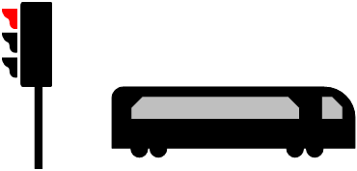
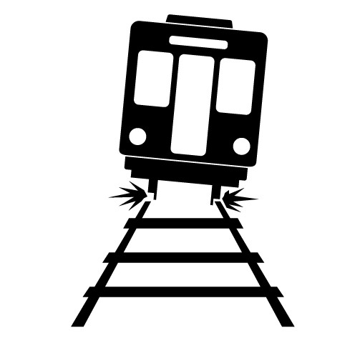
SEQUENCE OF EVENTS - EXAMPLE
Proceed Authority Exceeded
Collision
Derailment
Precursor Event
*Main Event*
Consequence Event
“
The occurrence report should firstly identify the main event, being the event with the most serious consequence or outcome. In this case, this would be the collision between the trains.
”
Office of the National Rail Safety Regulator
28

Slide 29
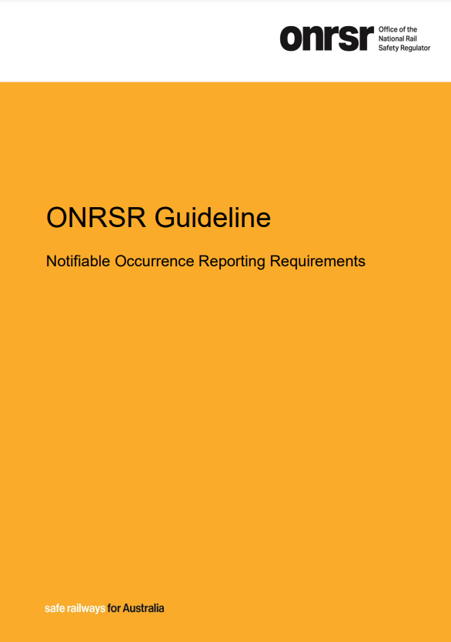
OCCURRENCE REPORTING
“
When entering Occurrence Reports and using the Notifiable Occurrence Reporting Requirements Guideline, it is important to refer to the ONRSR Business Glossary
”
Office of the National Rail Safety Regulator
29

Slide 30
ONRSR BUSINESS GLOSSARY
The terminology used within the Business Glossary is important for entering Notifiable Occurrences into the Portal
The Business Glossary provides definitions for consistent application and future analysis of information
The terms should only be used for reporting of notifiable occurrences, monthly activity and network and operations ontology
Office of the National Rail Safety Regulator
30

Slide 31
OCCURRENCE DATA SUBMISSION REQUIREMENTS
This Guideline:
Is in depth detail for personnel who manage and enter occurrence data
Provides detail for information management system development and handling of occurrence data
Outlines types of data required by ONRSR
Provides data item identifiers and formats within the ONRSR Portal
Office of the National Rail Safety Regulator
31

Slide 32
OCCURRENCE LOCATION DATA
Line section and associated kilometre point is required to be reported for any location-specific occurrence, however, if the relevant ontology data is provided by the rail infrastructure manager, an option to report locations based on key locations will be available.
Rail infrastructure manager line section and, if provided, optional key location data is made available to rolling stock operators as reference data when reporting the location of an occurrence.
Rail infrastructure manager occurrence report
Rail infrastructure manager defined line section and key location data is available as a data selection item for other operations to report occurrences on the manager’s network.
Rolling stock operator occurrence report
Office of the National Rail Safety Regulator
32

Slide 33
MODULE 3 – MONTHLY RAIL OPERATIONS ACTIVITY DATA
Office of the National Rail Safety Regulator
33

Slide 34
MONTHLY ACTIVITY REPORTING
The Monthly Activity Reporting consists of operational activity data, providing a view of the extent of an operator's activity in key operational and management areas. These include the following:
Freight train kms
Passenger train kms
Rolling stock operators on network (interfaces)
Rail Infrastructure Managers
Total number or FTE hours of rail safety workers (Employees & contractors)
Freight train kms
Passenger train kms & journeys
Maintenance train kms
Networks operated on (interfaces)
Rolling Stock Operators
Drug and alcohol testing
Office of the National Rail Safety Regulator
34

Slide 35
DRUG AND ALCOHOL TESTING
Regulation 56 outlines that the monthly return for drug and alcohol testing by rail transport operators must include the following:
The number and type of tests conducted
Whether the tests were conducted before or after the rail safety worker had signed on for duty
The class of rail safety work undertaken by rail safety workers who were tested
The employment relationship with the operator of rail safety workers who were tested
The outcomes of the tests.
Office of the National Rail Safety Regulator
35

Slide 36
DRUG AND ALCOHOL TESTING ACTIVITY
The ONRSR Guideline Monthly Activity Reporting provides a table which can be used for each rail safety worker type, within each Accredited State/ Territory:
Train Drivers
Guard
Shunter
Rolling Stock Maintainer
Train Controller/ Signaller
Station Staff
Railway Infrastructure Worker
Other
Test Type | Pre/Post Sign On | Positive |  | Negative |  | Refused |  | Tampered/ Interfered
 |  | Employee | Contractor | Employee | Contractor | Employee | Contractor | Employee | Contractor
Alcohol Breath Test | Pre sign on
 | Post sign on
Alcohol Breath Analysis | Pre sign on
 | Post sign on
Alcohol Blood Test | Pre sign on
 | Post sign on
Drug Oral Fluid | Pre sign on
 | Post sign on
Drug Blood Test | Pre sign on
 | Post sign on
Drug Urine Test | Pre sign on
 | Post sign on
Drug Test - Other | Pre sign on
 | Post sign on
Office of the National Rail Safety Regulator
36

Slide 37
MONTHLY ACTIVITY REPORTING
Data is to be submitted as soon as practicable after the end of each month.
This must be no later than the 21st day of the following month.
Office of the National Rail Safety Regulator
37

Slide 38
MODULE 4 – ANNUAL REPORTING
Office of the National Rail Safety Regulator
38

Slide 39
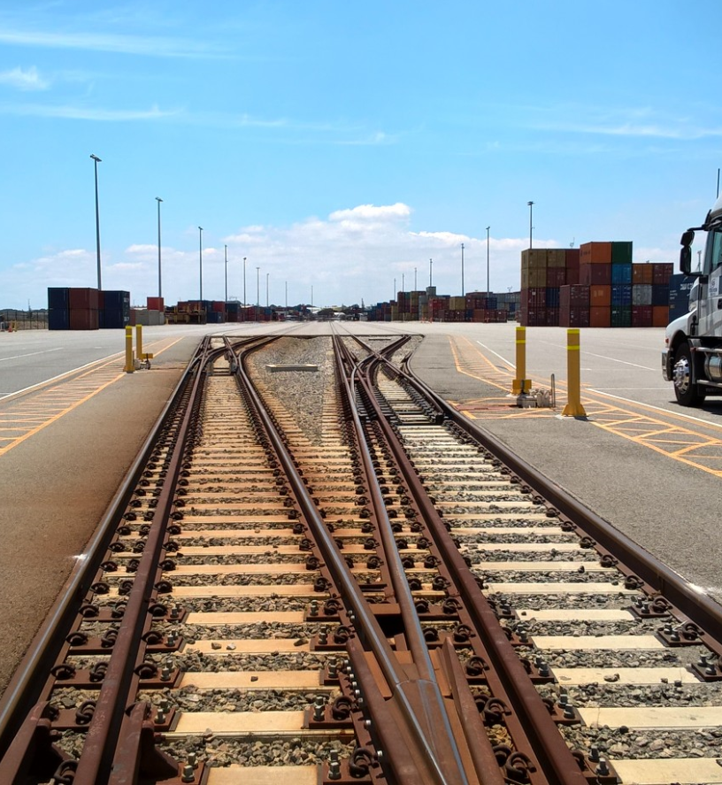
SAFETY PERFORMANCE
The RSNL requires accredited rail transport operators to submit a Safety Performance Report (SPR)
The SPR reporting period is either based on calendar year or financial year (or other agreed period), and is found on the Notice of Accreditation
The SPR must be submitted within 6 months after the end of the reporting period
Office of the National Rail Safety Regulator
39

Slide 40
WHY IS AN SPR REQUIRED?
The submission of an SPR provides detail for:
ONRSR to review operator rail safety performance
Operators to demonstrate the assessment of the effectiveness of the Safety Management System
Analysis of Category C occurrences by operators
An opportunity for operators to demonstrate safety improvements and ‘good news stories’
Information on emerging safety issues that might need wider communication or safety initiatives
Assisting ONRSR in scoping of regulatory and compliance activities
Office of the National Rail Safety Regulator
Office of the National Rail Safety Regulator
40

Slide 41
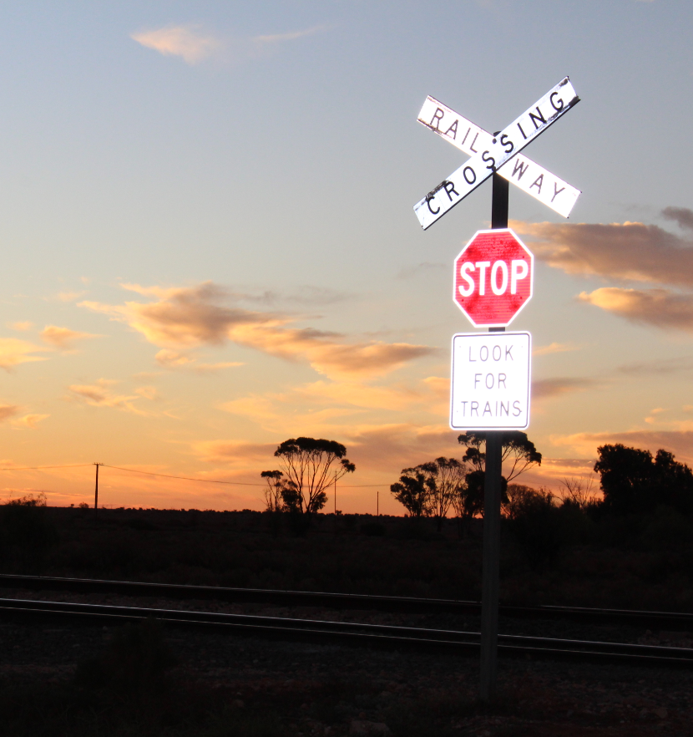
CATEGORY C REPORTING
Category C occurrences do not need to be reported to the Regulator at the time of the occurrence.
Data
Submission of Category C occurrences data should:
Be made on an annual basis via the Portal
Include the total number of each Type of Category C notifiable occurrences for each month of the reporting period
Further detail on data submission requirements can be found in the Occurrence Data Submission Requirements Guideline
Analysis
Category C occurrences should be analysed within the operators’ annual Safety Performance Report
The analysis should include an overview of Category C occurrences and how emerging trends have been treated
Note: ONRSR can require, by written notice, the submission of Category C occurrences outside this period.
Office of the National Rail Safety Regulator
41

Slide 42
ANNUAL RETURN
Rail Infrastructure Managers -
Operational/ non-operational track (km)
Rail network description & characteristics
Level crossing interfaces
Road manager interfaces
Other network interfaces (excluding Private Sidings)
The Annual Return contributes to ensuring accuracy of network and operational ontology and data.
Reporting must include these items where the operator has effective management and control.
Rolling Stock Operators -
Stations or stops utilised (Passenger Services)
The Annual Return must be submitted on or before 21 January
Office of the National Rail Safety Regulator
42

